Slide 1


Slide 2



Slide 3

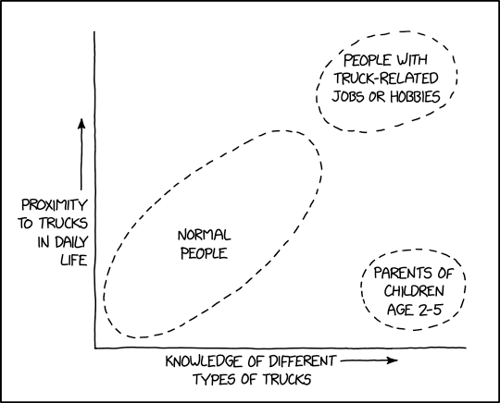


About Me
Josh Threet
https://www.linkedin.com/in/josh-threet-84743013/
Full Stack/MS Platforms
15 Years at Big G Express
Father of two, Kierce (9) & Kaelan (4)

Slide 4

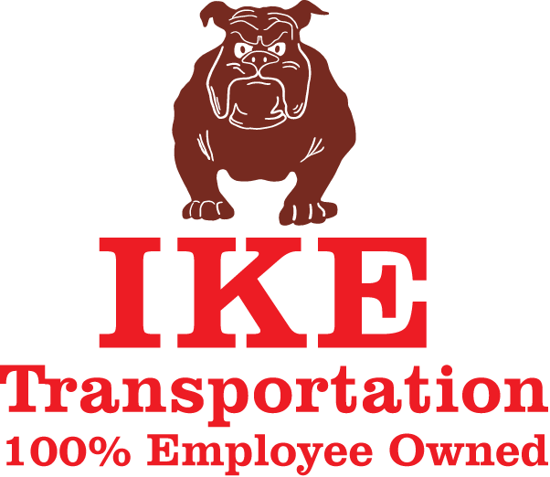
GOING THE EXTRA MILE SINCE 1995
Big G Express is 100% employee owned, asset-based truckload carrier, headquartered in Shelbyville, Tennessee. With 600 tractors and over 1,300 trailers, we provide general commodity, irregular route, dry van truckload and regional flatbed services to nationwide customers. By using state-of-the art equipment and the latest technologies, our trucking services and our employee-owners drive our success.

Slide 5
OUR Mission
The employee owners of Big G Express strive to provide business excellence for customers through an uncompromising commitment to safety, service, technology and integrity. Our services and solutions will meet and exceed customer expectations with a passion for performance and teamwork.

Slide 6
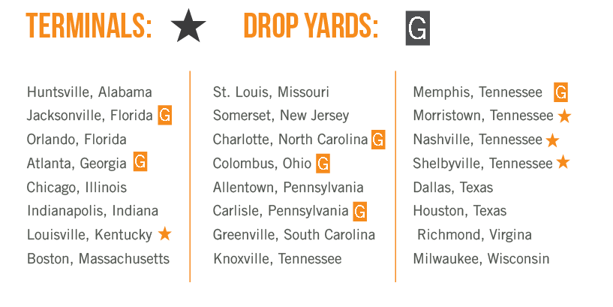
SERVICE
AREA MAP

Slide 7
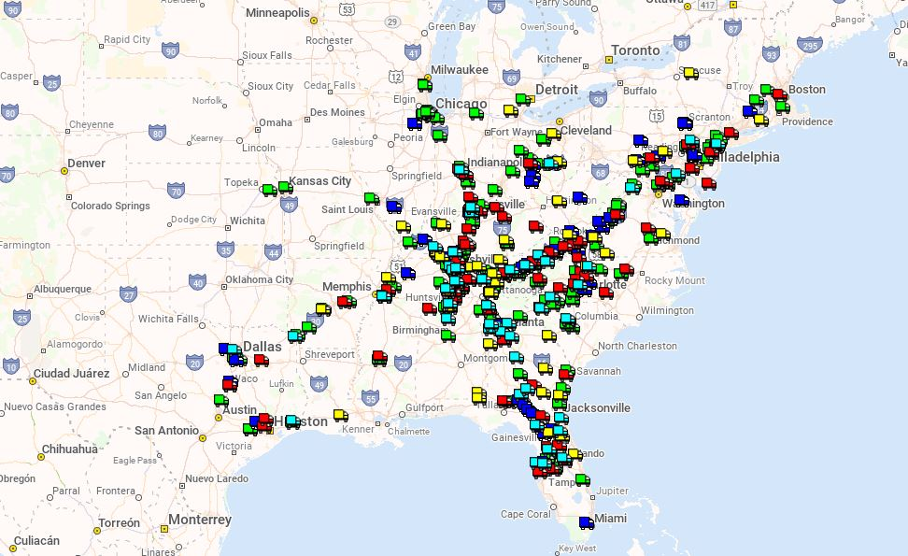
Fleet Footprint

Slide 8
Trucking in a nutshell
Contract to move freight for customer.
Determine dates and times for pickup and delivery
Pick up freight and deliver it on time as per Customer’s instructions…
Get Paid

Slide 9
But… it’s not quite that simple
Driver Shortage/Retention
Industrywide driver turnover rate around 90%
Driver/Equipment Utilization
How to maximize your return on investment in people/equipment?
Customer Data Requirements
How to provide your customers with the reporting/data that they require?
Equipment Maintenance
How to keep your fleet rolling and making money?
Paying your drivers
How to take care of your employees?
Safety
How to keep your people/the public safe?

Slide 10

But… it’s not quite that simple
Fuel
Fuel Economy
Fuel is expensive. What can you to do get the most miles out of a given gallon?
Fuel Purchasing
Fuel is expensive. How can you get the most fuel for your dollar?
Environmental Concerns
Trucking is a high-pollution business – how can we be responsible toward the environment?

Slide 11
A Dirty Business
Diesel emissions contain a number of problematic components –
Every gallon of diesel produces ~22.3 lbs of carbon emissions (total lifecycle)
NOx (Nitrous Oxide), a precursor to ozone.
Particulate matter (soot) – contains sulfates, ammonium, nitrates, some heavy metals, among other items.

Slide 12
Industry Solutions --
ULSD (Ultra-low Sulphur diesel fuel) was standardized nationwide in 2006. ULSD reduces the amount of NOX emissions, and reduces the hydrocarbon emissions to parity with gasoline.
Diesel Particulate Filters – First used in cars as early as 1985, their use in heavy road tractors is near universal today. DPF’s can reduce the amount of soot emitted by a vehicle by up to 95%.
Idle Reduction – Most over the road tractors are equipped with Auxiliary Power Units, which provide power and driver comfort, so that the engine does not have to be idled. These are much more fuel efficient than idling the engine, and produce much lower emissions.
Efficiency Gains – In the past 15 years, our fleet-wide fuel efficiency has gone from approx. 6 MPG to approx. 7.1 MPG.

Slide 13
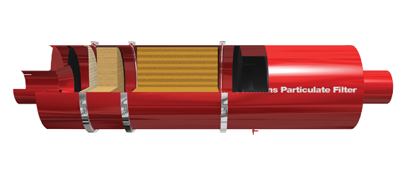
Diesel Particulate Filter
Diesel Oxidation Catalyst
Wall-Flow Filter
Cummins Particulate Filter

Slide 14
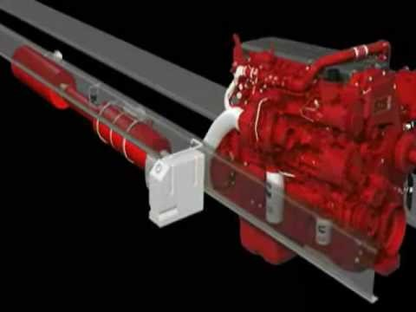
Diesel Aftertreatment

Slide 15
Why We’re Here
When these systems operate properly, emissions are controlled, and the truck operates as normal, emissions are reduced, freight makes it to the destination on time, and the driver is able to drive more miles.
But when they fail…

Slide 16

Why We’re Here
Modern commercial emissions controls have a “carrot and stick” approach to encourage these issues to be fixed…
Unlike consumer vehicles, commercial vehicles will quickly enter a “de-rate” state over emissions systems issues (similar to “limp-home” modes in consumer vehicles).
Most consumer vehicles will continue to operate normally with emissions systems issues (like EGR issues, O2 sensor issues, etc).

Slide 17
Derates
There are two main types of derate states that we see on a regular basis --
A 75% derate (SPN = 1569, FMI = 31) Reduces engine torque by 25%.
This mode will require service to clear, but is generally manageable by routing the truck to the nearest maintenance facility.
A idle level derate (SPN = 5246) will require a tow.
Not only will we miss delivery service on this load (which can sometimes drastically affect the customer’s operations), we will have to pay around $4000 for towing, plus the cost of repairs.

Slide 18
Further Impacts
Ripple effect of downtime --
Freight is an industry built on assumptions & schedule –
The equipment will be available and in good order.
It takes a certain amount of time to get from point A to point B
The Driver has a fixed amount of on-duty time to complete the assignments given (Federal Hours of Service Regulations)

Slide 19
Further Impacts
There are a lot of moving pieces on the chess board for moving freight.
Losing a piece of equipment and driver will have a cascading impact as other trucks are rescheduled to minimize the disruption to the customer.
As of today: 513 seated trucks 505 Drivers on duty 326 loads scheduled to deliver
325 loads scheduled to pick up

Slide 20
Further Impacts
Many of our customers employ “Just In Time” delivery. If we’re late, it can potentially idle a factory. Many customers have implemented fines on carriers for late delivery.
Drivers have a federally mandated schedule that must be kept – 11 hours driving out of a 14 hour work day. Time spent dealing with a breakdown or waiting on a repair goes against their 14 hours. Time not spent driving is time they are not earning money. (We offer adjustment pay when a breakdown takes a longer period of time, but it’s better for everyone if we avoid the breakdown in the first place).

Slide 21
Failure Prediction
We’d like to see if there is way from these data feeds to determine if a truck is likely to fail soon, before it does.
The earlier we can predict the failure, the better we can work the repair into everyone’s schedule.

Slide 22

Data Feed
We receive the data feed via web service feed from our telematics provider, Omnitracs. The feed is near real-time, over terrestrial cellular network.

Slide 23

QCJ1939Fault
J1939 is the vehicle data bus for commercial trucks. Similar in concept to OBDII interface on consumer vehicles.
Shows which ECM Generated the fault.
Parent record for QCVehDiagOnboardData (1:n)
QCVehDiagOnboardDatas
Can vary by event type.
Variable data type

Slide 24
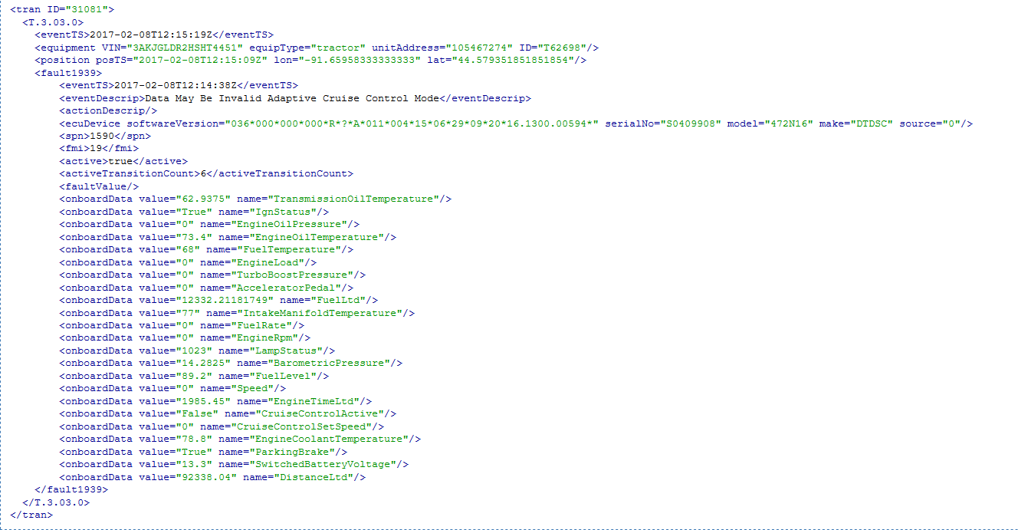
Data Available (continued)

Slide 25
Goal
Our engine vendor provides a fault monitoring service that uses this same data feed. We’d like to be able to cross-check this service against our own data, as well as perhaps apply the information to vehicles that are not using Cummins engines.

Slide 26
CONTACT
Josh Threet (joshthreet@biggexpress.com)
Ryan Steagall (ryansteagall@biggexpress.com)
P.O. Box 1650, Shelbyville TN, 37162
^{www.BigGExpress.com}

